Slide 1
Week 06

Slide 2
Updates
Quiz 2 Review: https://github.com/pattonsgirl/Fall2021-CEG2350/blob/main/Quizzes/Quiz2.md
Lab 04 - 10% off per day until Thursday, 9/30
Lab 05 - Due Tuesday 10/5
Quiz 3 - 10/7
Midterm - 10/14
1.5 hours once started
1 attempt
Open 8:00 AM - 11:59 PM

Slide 3
Lab 04 Notes
Some good questions that cropped up
What should be executable?
What is ~/.profile doing?
Letting a command have “modes”
There is a way to properly create “options” instead of string compares
But I expected use of string compares of arguments passed

Slide 4
Computer Hardware

Slide 5
Von Neumann Architecture
Electronic digital computer with features:
Processing unit
Arithmetic logic until + process registers
Control unit
Instruction register + program counter
Memory
Store data + instructions
External mass storage
IO mechanisms
This is still the basis of modern computers

Slide 6
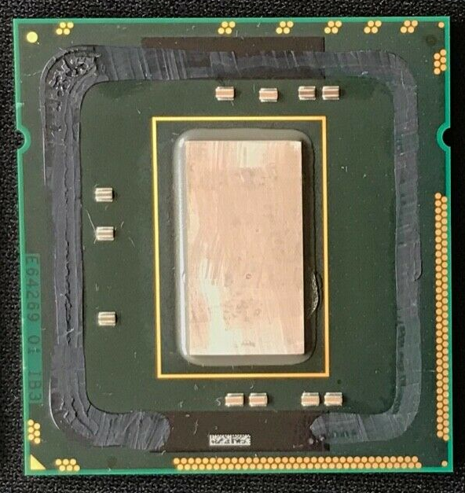
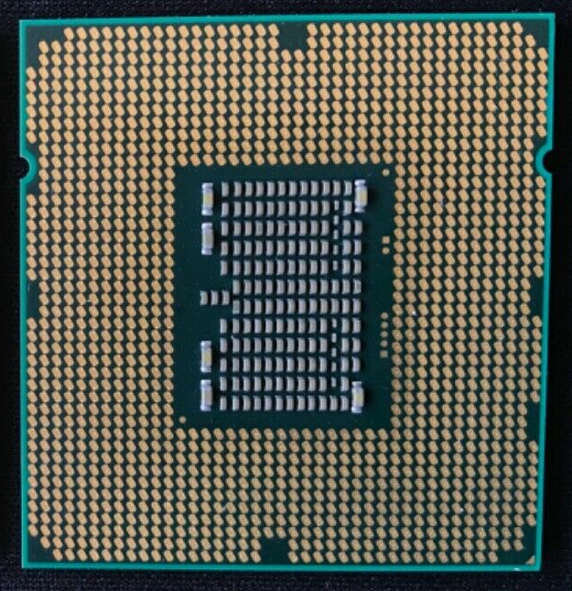
CPU = Central Processing Unit
Responsible for processing all information from programs run by your computer
Clock speed of CPU governs how fast it executes instructions and is measured in GHz (usually between 1 and 5 GHz)
Usually cooled by a heat sink and fan, or water-cooling system
Most newer CPU includes an on-die graphics processing unit (GPU)
Notes:
https://www.computerscience.gcse.guru/theory/von-neumann-architecture
https://en.wikipedia.org/wiki/Computer_hardware
https://www.crucial.com/articles/pc-builders/what-is-computer-hardware

Slide 7
The CU, ALU, and MU
The CPU contains the ALU, CU and a variety of registers.
The ALU (Arithmetic and Logic Unit) allows arithmetic (add, subtract etc) and logic (AND, OR, NOT etc) operations to be carried out
The CU (Control Unit) controls the operation of the computer’s ALU, memory and input/output devices, telling them how to respond to the program instructions it has just read and interpreted from the memory unit.
The control unit also provides the timing and control signals required by other computer components.
The memory unit consists of RAM, sometimes referred to as primary or main memory
RAM is split into partitions. Each partition consists of an address and its contents (both in binary form)
Notes:
https://www.computerscience.gcse.guru/theory/von-neumann-architecture

Slide 8
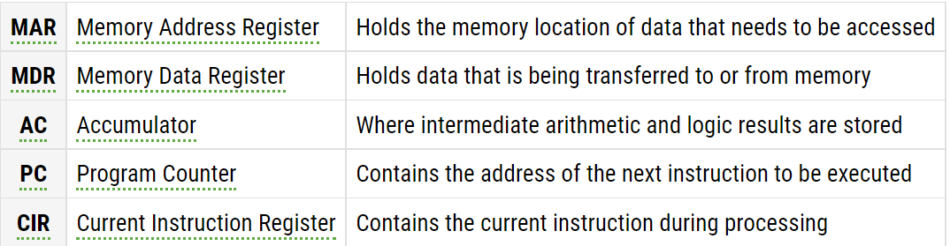
CPU Registers
Registers are high speed storage areas in the CPU. All data must be stored in a register before it can be processed
Notes:
https://www.computerscience.gcse.guru/theory/von-neumann-architecture

Slide 9

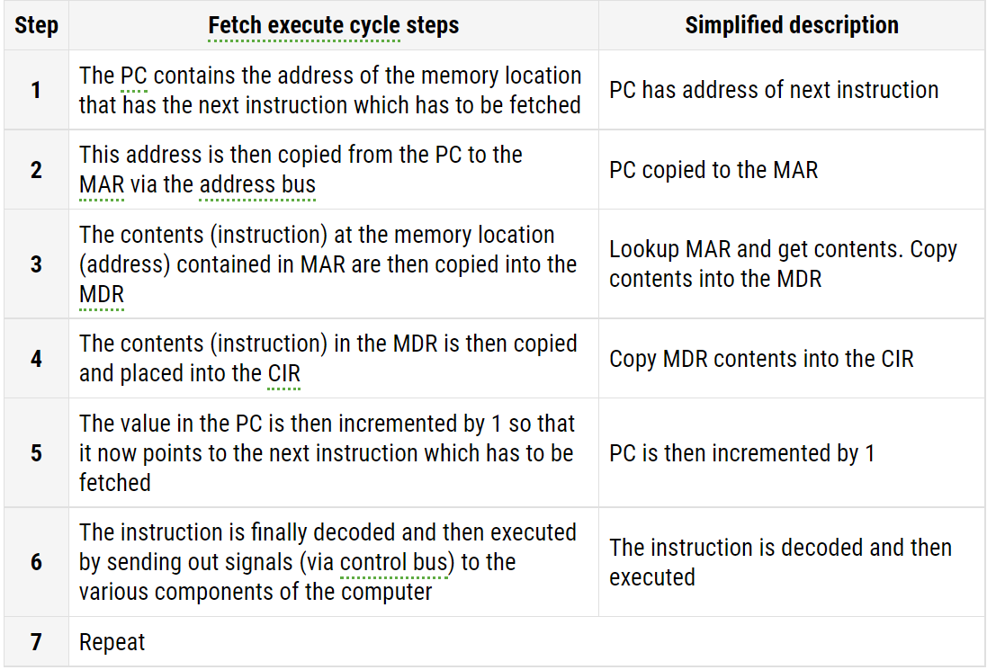
CPU - Fetch execute cycle
Basic instruction cycle of the CPU
AKA. Fetch, decode, execute cycle
Notes:
https://www.computerscience.gcse.guru/theory/fetch-execute-cycle

Slide 10
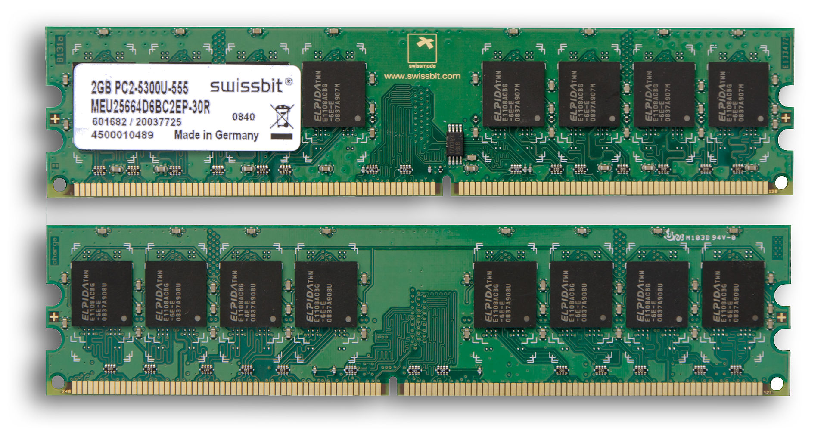
RAM
RAM = Random Access Memory
Stores the code and data that are being actively accessed by the CPU
Volatile – contents are erased if power is lost
MOS memory chips store data on memory cells consisting of MOSFETs and MOS capacitors
Notes:
https://www.redhat.com/sysadmin/memory-and-storage
https://www.crucial.com/articles/about-memory/support-what-does-computer-memory-do

Slide 11
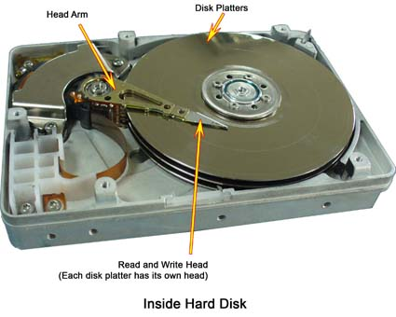
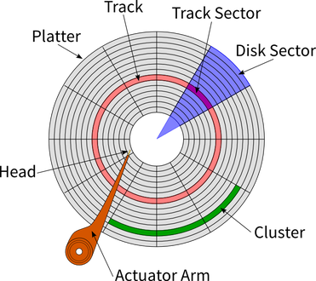

HDD
HDD = Hard Disk Drive
Non-volatile – information persists after power reset
Data is stored on platters
Data stored magnetically
Disk fragmentation over time
Notes:
https://blogs.umass.edu/Techbytes/2017/04/04/hard-drives-how-do-they-work/
https://cs.stanford.edu/people/nick/how-hard-drive-works/
https://en.wikipedia.org/wiki/Computer_hardware

Slide 12
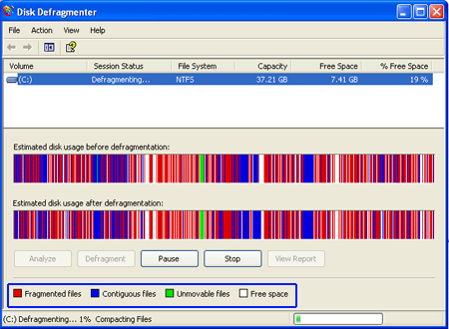








Fragmentation

Slide 13
How do reads & writes happen?
Temporarily stored on HDD cache while head wanders around to correct areas
Head magnetizes the data to the disk
Never forget - at some point it’s all binary!
Notes:
https://en.wikipedia.org/wiki/Computer_data_storage

Slide 14
SSD
SSD = Solid State Drive
Stores data on semi-conductor cells
Data in bits are stored on these cells
Has a built in controller
Wear leveling
Read & write caching
Non-volatile
Notes:
https://en.wikipedia.org/wiki/Solid-state_drive

Slide 15
HDD vs SSD: Pros and Cons
SSD’s are faster in terms of data access & read / write speeds
HDD failures are easier to detect
Slow down of head movements over time
Loud noises since it’s all mechanical
SSDs don’t do scary noises – can use software to detect decrease in read / write speeds that would point to failure

Slide 16


“Virtual” Memory
Memory on CPU cache & RAM – chip based, finite.
Memory on disk – finite, but large. Can define some space as overload
Use cases:
Putting a PC in “sleep” mode
Keep active areas / processes in RAM, offload rest
Notes:
https://www.howtogeek.com/126430/htg-explains-what-is-the-windows-page-file-and-should-you-disable-it/
https://www.thegeekdiary.com/beginners-guide-to-swap-space-management-in-linux/
https://www.internalpointers.com/post/introduction-virtual-memory

Slide 17
How does virtual memory work?
CPUs now have an MMU
Memory Management Unit
The MMU has a map of addresses
Think 0 - x addresses on RAM 0 - x addresses on disk
CPU only cares that it get the info. The MMU acts as translator
This also allows virtual memory to be contiguous
Processes / programs also like thinking they have a reserved “block” of memory, even if it is actually split between RAM and disk
This is tracked on a page table, stored in the MMU
Notes:
https://www.internalpointers.com/post/introduction-virtual-memory
http://csapp.cs.cmu.edu/2e/ch9-preview.pdf

Slide 18
Motherboard
Buses to facilitate communication of devices
RAM & CPU have dedicated bus between them
RAM has busses to other spots (HDD, GPU, etc)
Has specific hardware it can support
CPU sockets that handle specific CPU pins, for example
$ lshw
All hardware connected to system
msinfo
Notes:
https://computer.howstuffworks.com/motherboard3.htm

Slide 19
Motherboard
Houses the CPU and is a hub that all other hardware runs through
Acts as a brain; allocating power where it’s needed, communicating with and coordinating across all other components
The chipset is part of the motherboard's logic system and is usually made of two parts -- the northbridge and the southbridge.
These two "bridges" connect the CPU to other parts of the computer.
Each bridge is a separate chipset on the motherboard
BIOS / UEFI is on ROM chip on motherboard
https://www.tomshardware.com/reviews/motherboard-parts-explained,5669.html
Notes:
https://www.crucial.com/articles/pc-builders/what-is-computer-hardware
https://pediaa.com/difference-between-northbridge-and-southbridge/

Slide 20
ROM
ROM = Read only memory
Non-volatile chip
Stores the BIOS that runs when the computer is powered on or otherwise begins execution
These days ROM and the BIOS is a fuzzy line
You can update it

Slide 21

GPU = Graphical Processing Unit
Specialized electronic circuit designed to rapidly manipulate and alter memory to accelerate the creation of images in a frame buffer intended for output to a display device
Dedicated:
A separate card that has its own power lines, ram (VRAM) and cache
Integrated:
CPU & GPU capabilities combined. CPU gets priority
Discussion on needs (when to choose)
Notes:
https://www.makeuseof.com/tag/can-shared-graphics-finally-compete-with-a-dedicated-graphics-card/
https://www.reddit.com/r/explainlikeimfive/comments/pdxy6s/eli5_why_does_a_computer_need_a_dedicated/
https://en.wikipedia.org/wiki/Graphics_processing_unit

Slide 22
Class Builds a PC
Can play Destiny 2
Can dual boot?
Can experiment with machine learning

Slide 23
Lab 05 Notes
$ whoami
$ whois
$ echo $EUID
Little ID checker script
For system discovery parts:
Part 1: write details for your system
Part 2: use commands to find system information
The commands are mostly provided. What the command is showing you is not ;) Check out those man pages and google searches

Slide 24
#! /bin/bash
echo $EUID
if [[ $EUID -eq 1000 ]]
then
echo "Hello ubuntu"
fi

Slide 25
The Boot Process
In this part, we will assume a PC with an OS installed

Slide 26
BIOS / UEFI
BIOS = Basic Input Output System
UEFI = Unified Extensible Firmware Interface
Stored on chip on motherboard
Detects boot partitions on connected devices (disks or external drives)
UEFI is the correct modern word. Most people still refer to it as the BIOS, and UEFI is assumed

Slide 27
POST
Power On Self Test
Checks hardware for compatibility & connectivity
Where the beep codes come from – which piece of hardware failed to pass muster
Once POST is done, hand back to BIOS

Slide 28
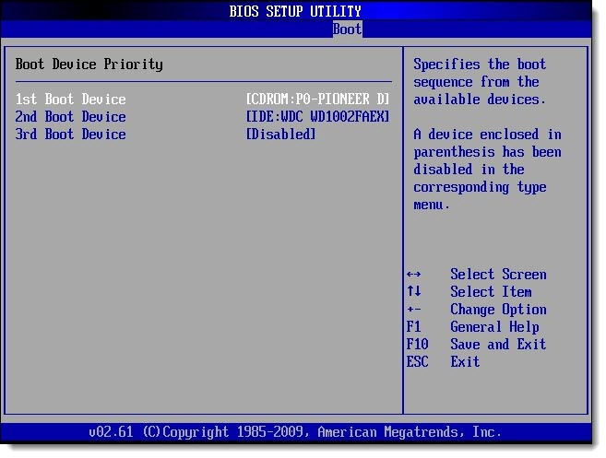

Slide 29
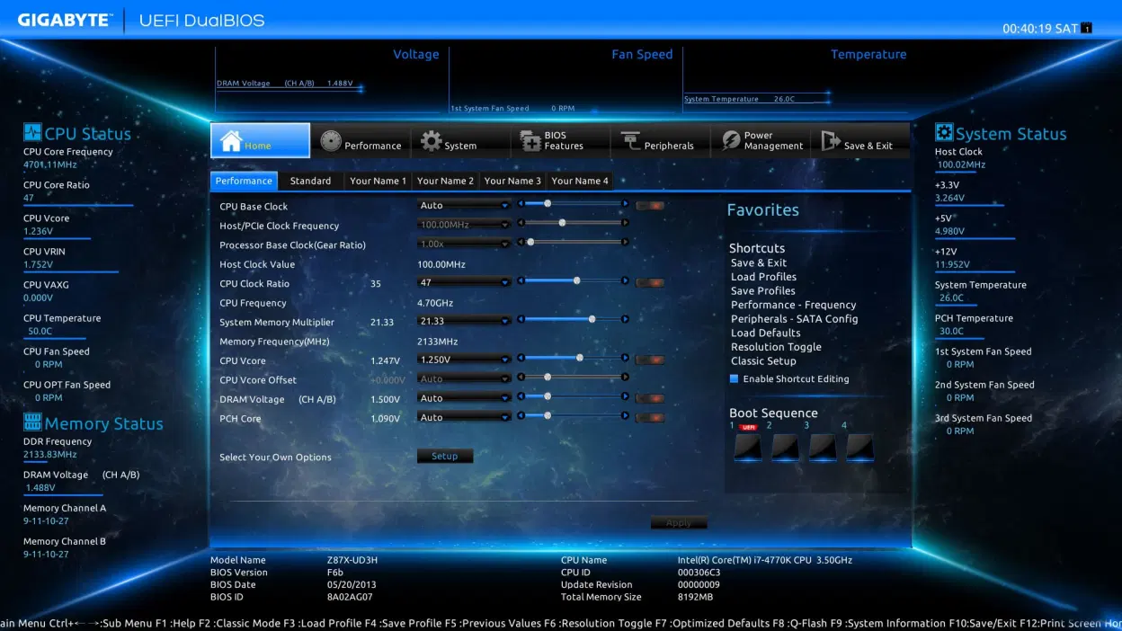
Notes:
https://www.howtogeek.com/56958/htg-explains-how-uefi-will-replace-the-bios/
https://www.partitionwizard.com/partitionmagic/uefi-vs-bios.html

Slide 30

MBR & GPT
Primary partition tables
Hold the system bootloader
MBR = Master Boot Record (use with BIOS / legacy mode)
GPT = GUID Partition Table
Partition tables determine:
Which partition(s) are bootable
Where partitions start / end
Notes:
https://www.howtogeek.com/193669/whats-the-difference-between-gpt-and-mbr-when-partitioning-a-drive/
https://www.diskgenius.com/how-to/mbr-vs-gpt.php

Slide 31
MBR
MBR = Master Boot Record
MBR holds the partition table and boot loader in the same partition
This is not great for recovery if the info is corrupted
There are 4 primary partitions at most on MBR disk. The 64 bytes in the first sector is used to save partition information, and each partition requires 16 bytes.
Works with disk capacity up to 2 TB
BIOS uses disks with MBR partition schemes
A UEFI BIOS would need to have “legacy” mode enabled to read disks with MBR
Notes:
https://www.diskgenius.com/how-to/mbr-vs-gpt.php

Slide 32
GPT
Bootloader is stored in EFI partition
Peek at this in Windows using the Disk Partition Manager
Reserve MBR. On GPT disk, the first physical sector on is still MBR which has talked in previous part. This MBR here does not have actual function and it exists only due to the consideration of software compatibility.
Primary GPT header stores right behind protective MBR on second physical sector. The GPT header defines partition number. Basically, you can deem that there is no limitation on partition number of GPT disk.
In fact, the third sector is the beginning of the actual partition table. Please note that each sector can store 4 partitions' information, which means every partition needs 128 bytes to store partition information.
Notes:
https://www.diskgenius.com/how-to/mbr-vs-gpt.php

Slide 33
MBR vs. GPT
If your BIOS is in UEFI mode, disks cannot use MBR only GPT
GPT supports up to 9.4 ZB disk capacity
vs MBR at 2TB cap
GPT supports up to 128 partitions
vs 4 primary partition cap on MBR
Notes:
https://www.diskgenius.com/how-to/mbr-vs-gpt.php
https://neosmart.net/wiki/mbr-boot-process/

Slide 34
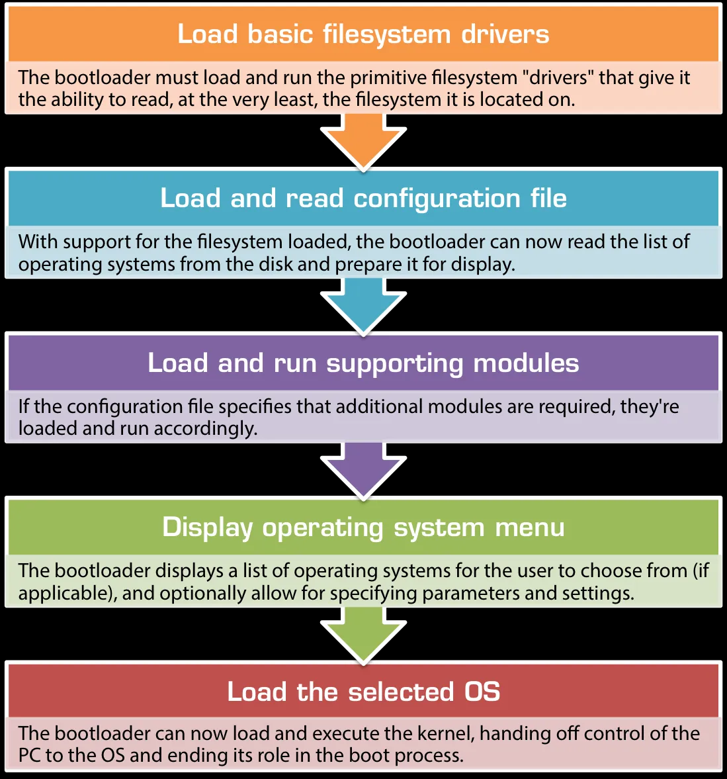
Bootloader ToDos
Notes:
https://neosmart.net/wiki/mbr-boot-process/
https://medium.com/@workrockin/what-are-bootloaders-54933fec4bb5

Slide 35
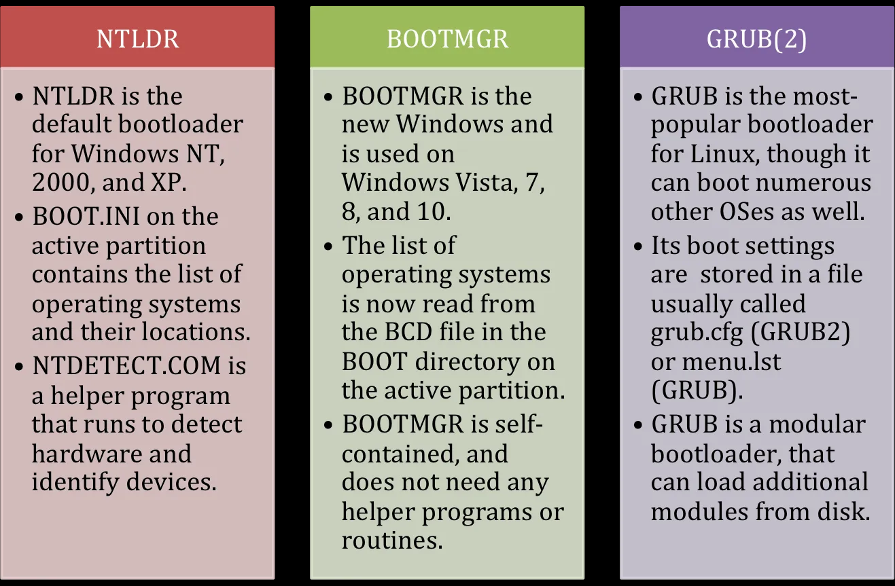
Bootloaders

Slide 36
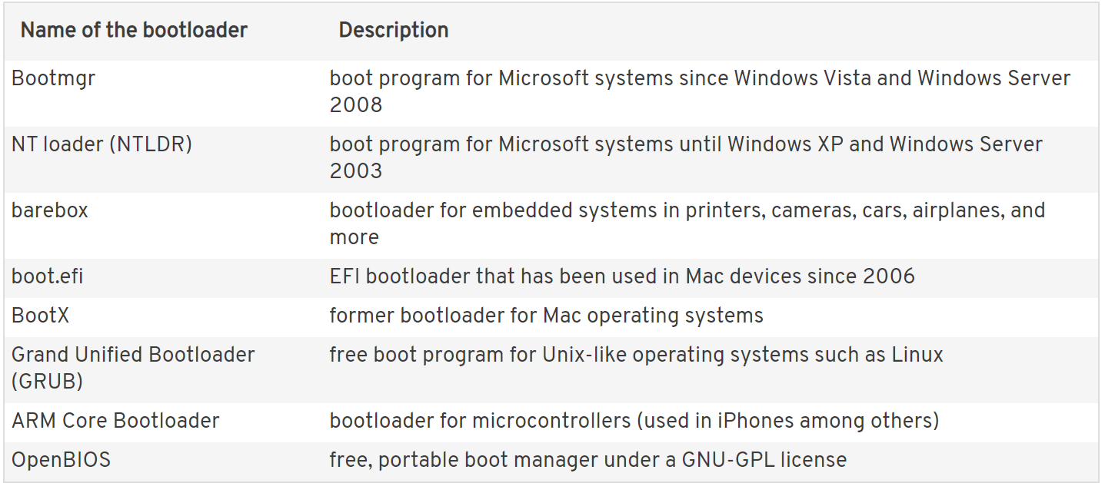
Most common bootloaders

Slide 37
Boot Menu Options Include
Choose OS or version of OS
Safety mode
Memory diagnostic tool
Bootloader passes control to kernel
Kicks off initial processes to load OS

Slide 38
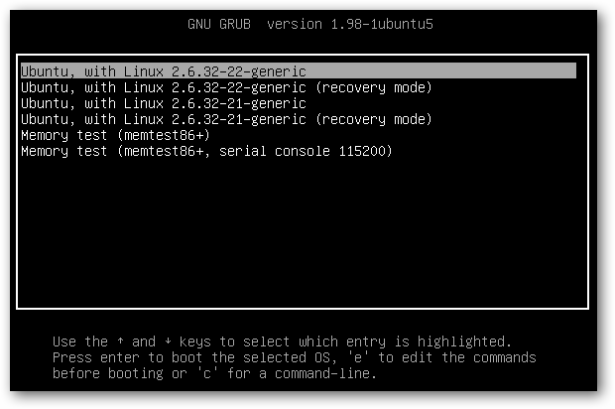
Grub
Notes:
https://linuxhint.com/what-is-a-boot-loader/

Slide 39
Why people love grub…
https://www.addictivetips.com/ubuntu-linux-tips/best-grub2-bootloader-themes-on-linux/

Slide 40
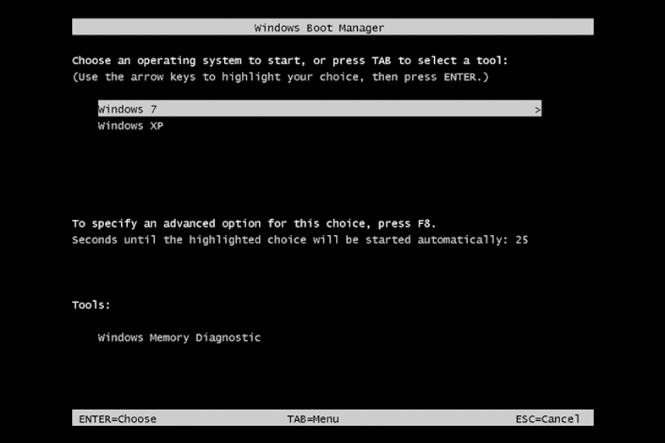
BootMGR
Notes:
https://linuxhint.com/what-is-a-boot-loader/

Slide 41
Kernels
Interface between hardware and OS
Memory management:
Keep track of how much memory is used to store what, and where
Process management:
Determine which processes can use the central processing unit (CPU), when, and for how long
Device drivers:
Act as mediator/interpreter between the hardware and processes
System calls and security:
Receive requests for service from the processes
Notes:
https://www.redhat.com/en/topics/linux/what-is-the-linux-kernel

Slide 42

Linux Kernel
The kernel is the version number - the core of the system
OS is the “Pretty Name” that determines how the user space runs
https://distrowatch.com/

Slide 43
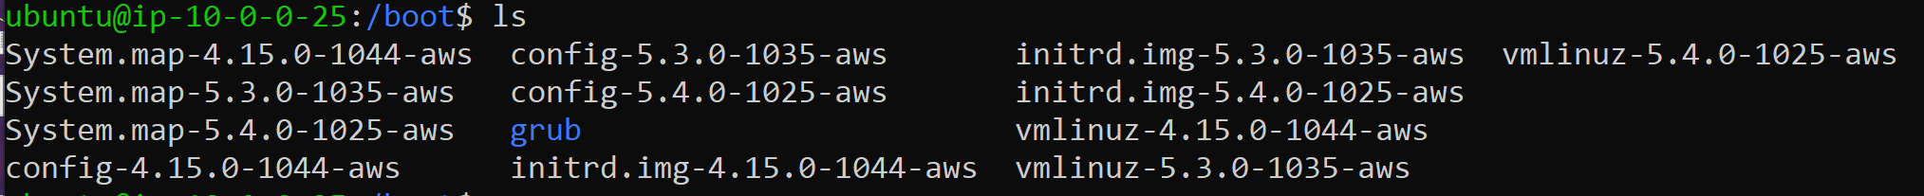
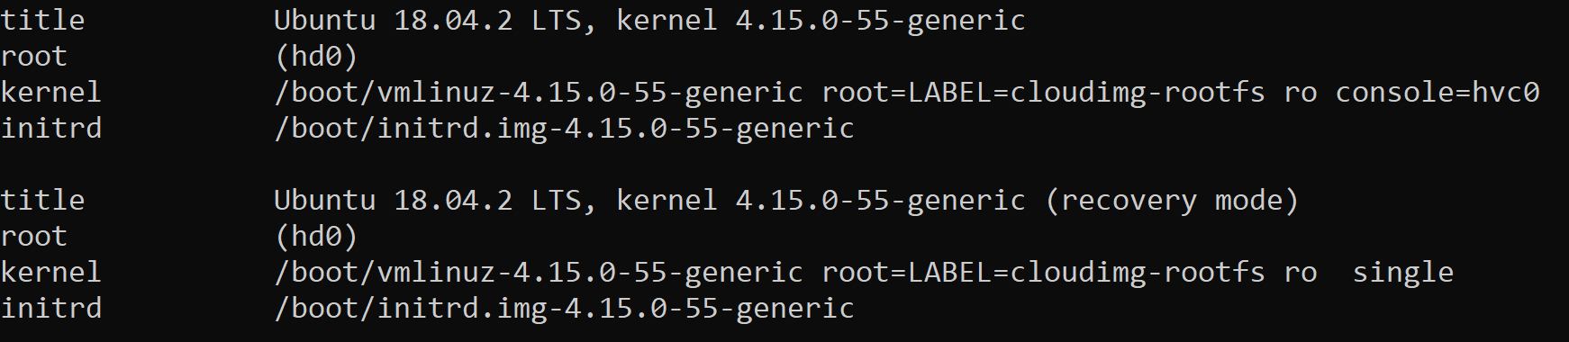
The Kernels
The GRUB Menu

Slide 44
Windows Kernel
Winload.exe (Windows Boot Loader) is a small piece of software, called a system loader, that's started by BOOTMGR, the boot manager used in Windows 10, Windows 8, Windows 7, and Windows Vista operating systems.
The job of winload.exe is to load essential device drivers, as well as ntoskrnl.exe, a core part of Windows.
Notes:
https://www.lifewire.com/what-is-winload-exe-2626051

Slide 45

